Slide 1

Team Name: Arrowsbah24
Team Members Details:
Jashanpreet Singh Dingra (Guru Nanak Dev University, Amritsar)
Manam Tiwari (BNM Institute of Technology)
Pratham Jain (IIIT Raichur)
Uttakarshika (IIIT Raichur)

Slide 2
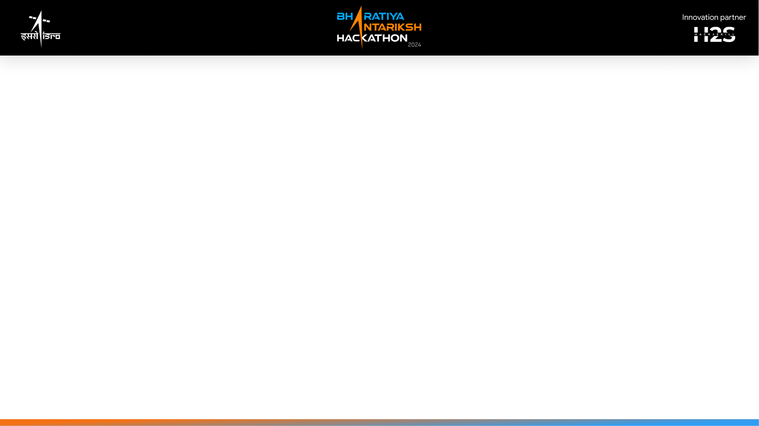
Tools and Technology Used (50 words)
Astropy: A powerful library for astronomy that provides functionalities for:
FITS file handling (astropy.io.fits): Reads and writes data stored in Flexible Image Transport System (FITS) format, commonly used in astronomy.
Time manipulation (astropy.time): Handles astronomical time scales and conversions.
Coordinate systems (astropy.coordinates): Defines and works with celestial and terrestrial coordinate systems.
Unit conversion (astropy.units): Converts between various astronomical units.
Periodogram calculation (astropy.timeseries): Calculates the Lomb-Scargle periodogram to identify periodic signals in unevenly sampled data.
Matplotlib: A popular library for creating visualizations in Python.
Collections (defaultdict): A dictionary subclass that provides a default value for missing keys, useful for grouping data by year in this case.
NumPy: A fundamental library for scientific computing in Python, used here for polynomial fitting and calculations.
Datetime: Built-in Python module for working with dates and times, used for converting observation times to years.

Slide 3
Tools and Technology Used (50 words)
These tools work together to achieve the following:
1.Data Loading and Correction (FITS, Time, EarthLocation):
Load data from FITS files containing pulsar observations.
Convert timestamps to a common time format (Time).
Apply barycentric correction to account for the Earth's motion (EarthLocation).
2.Period Calculation (LombScargle):
Calculate the rotation period of the pulsar using the Lomb-Scargle periodogram for each observation.
3.Yearly Analysis (collections.defaultdict):
Group observations by year.
Calculate the mean period for each year's observations.
4.Plotting and Trend Analysis (Matplotlib, NumPy):
Create plots to visualize the observed periods and their mean values over time.
Fit a linear trendline to estimate the pulsar's spin-down rate.

Slide 4
Detailed solution and Approach (250-300 words)
To analyze the Crab Pulsar's spin-down event, we followed a systematic approach involving data collection, processing, and analysis. We accessed the AstroSat data archive portal of the Indian Space Science Data Center (ISSDC) at AstroBrowse to download the required AstroSat data. We selected long observations of the Crab pulsar spanning different years using the LAXPC and CZTI instruments of AstroSat, ensuring the duration exceeded 60 minutes.
Next, we applied barycentric correction to the photon arrival times of the observations to obtain accurate pulse profiles and measure the pulse period. We analyzed these pulse profiles to determine the rotation period of the Crab pulsar during different time intervals.
Observations were plotted with the pulse period on the y-axis and the year on the x-axis. Key statistical features such as mean periods for each year, a linear trend line, and a mean period spline were added to visualise the data accurately. Our analysis also accounted for glitches experienced by the pulsar during this period, as discussed in literature A&A.
In addition, we plotted the pulse period data from 2015 to 2022. Observations were visualized with mean periods for each year, a linear trend line, and a mean period spline. This revealed a complex trend: an initial increase in the pulse period from 2015 to 2017, a significant decrease from 2017 to 2018, followed by stabilization from 2018 to 2022.

Slide 5
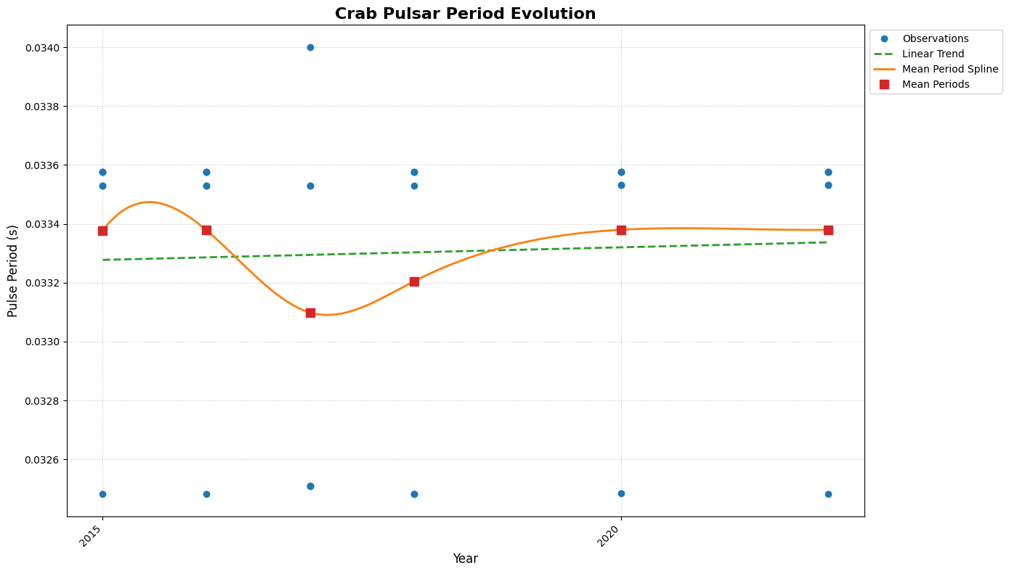
Figure1: LAXPC Instrument data applying barycentric correction, and measuring pulse periods. The pulse period data from 2015 to 2022 was plotted with mean periods, a linear trend line, and a spline, revealing an initial increase, a significant decrease, and then stabilization over time.

Slide 6
Detailed solution and Approach (250-300 words)
Historically, prior to the 2011 glitch, the pulsar had a consistent spin-down rate. Post-2011 glitch, the spin-down rate decreased sharply, followed by an unexpected speed-up around 1200 days after the glitch. Pre-speed-up, the spin-down rate was approximately -3.78 × 10^-10 Hz/s. Post-speed-up, the rate changed by +0.15 × 10^-10 Hz/s, indicating a 15% reduction in deceleration.By comparing the rotation periods measured across various time intervals, we computed the change in the rotation period of the pulsar over time. We compared our results against research papers and data sources like Jodrell Bank to evaluate accuracy.
The differences in rotation period we found were:
Year 2016: Difference = -1.0420%%
Year 2017: Difference = -1.9090%
Year 2018: Difference = -1.6326%
Year 2020: Difference = -1.1838%%
Year 2022: Difference = -1.2585%
Year 2015: Difference = -1.0002%
Our analysis also accounted for glitches experienced by the pulsar during this period, as discussed in literature A&A in the study "45 Years of Rotation of the Crab Pulsar" which documents 24 such glitches recorded over 45 years since 1984.

Slide 7
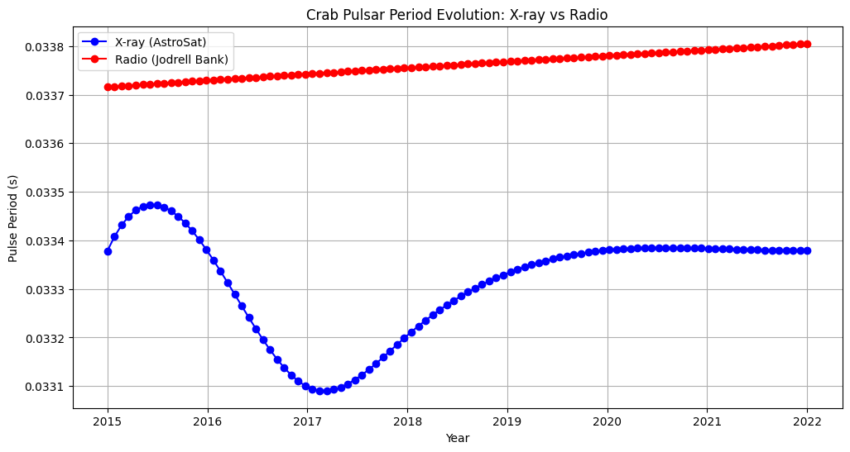
Figure3: Comparison of Crab Pulsar pulse periods from X-ray (AstroSat) and radio (Jodrell Bank) observations. The plot shows the evolution of pulse periods over time, with smooth curves representing both X-ray and radio data. The data points are corrected for various time discrepancies, including barycentric correction. Notable differences between the two measurement types are indicated

Slide 8

Why Choose us ?
What is different with our approach ?
How do we solve this problem ?
What is our USP ?

Slide 9
While many studies have investigated the spin-down of the Crab pulsar, this solution distinguishes itself by:
Comprehensive Methodology: Unlike studies that often focus on a single technique (e.g., linear regression), this approach incorporates multiple methods (linear regression, moving averages, exponential fitting, residual analysis) for a more robust analysis on ASTROSAT Archive data.
Framework for Advanced Techniques: While the core analysis uses standard methods, the code structure is designed to accommodate more complex techniques like Gaussian process regression or time series decomposition in future work.

Slide 10
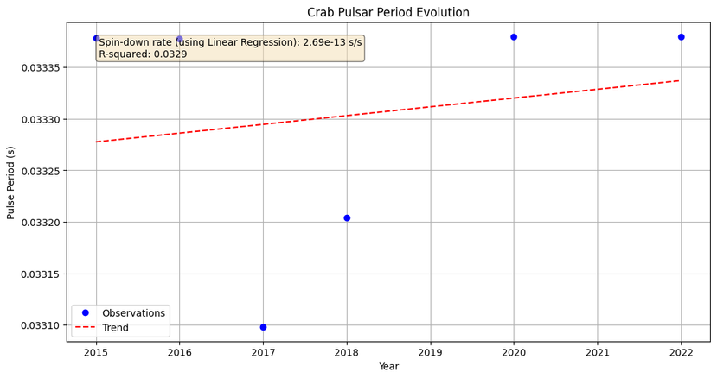
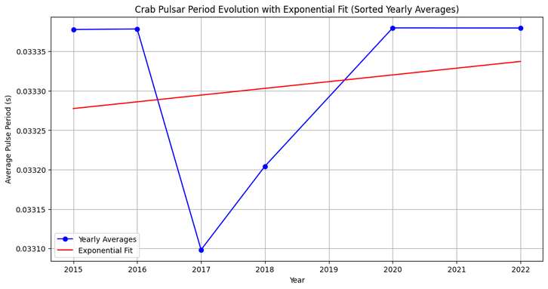
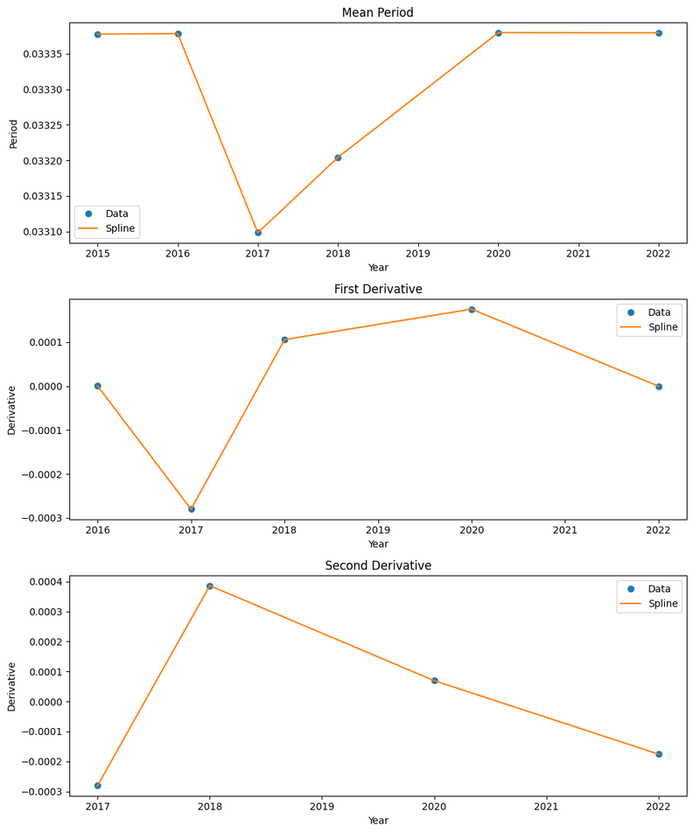
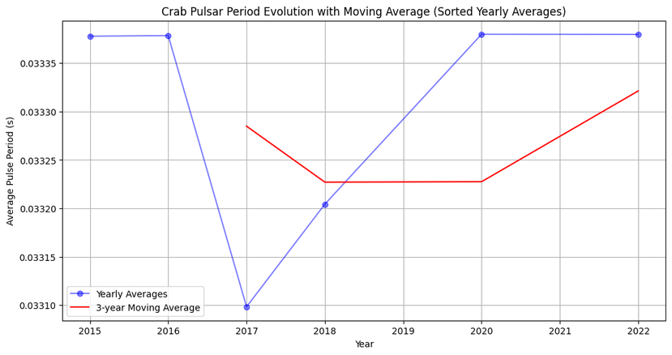
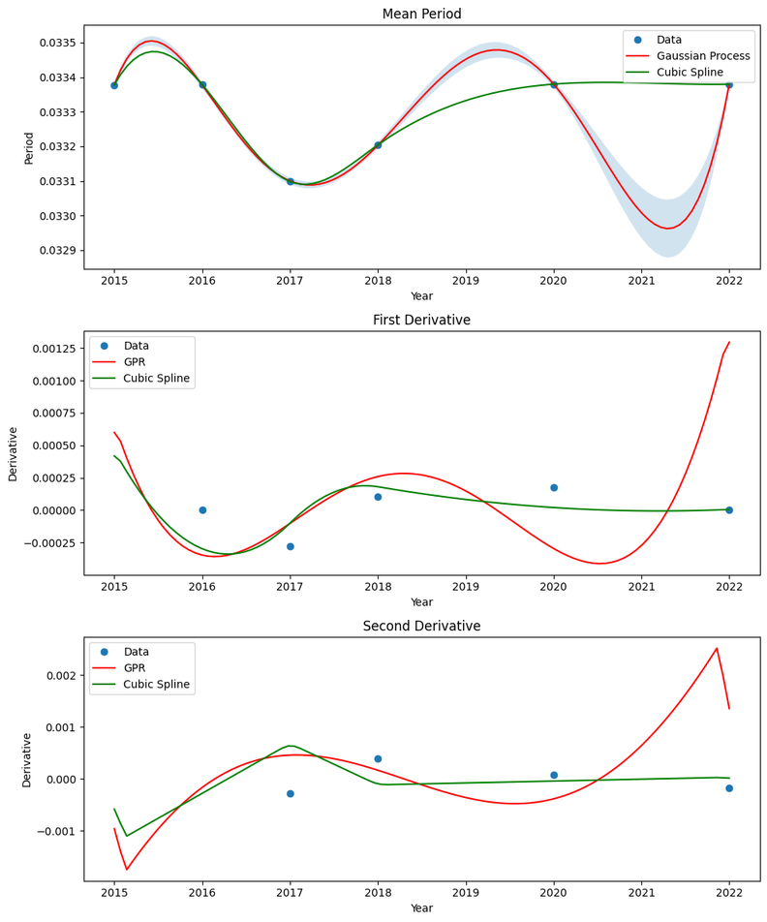
Strong Emphasis on Visualization: The use of various plots to visualize data trends, residuals, and model fits provides a deeper understanding of the pulsar's behaviour compared to studies that rely solely on numerical results.
Implementation: https://colab.research.google.com/drive/1DcTDD2JTp8OvoaUQZmSXmq8Y3o6BMJ-R?usp=sharing

Slide 11
Provides Explanation of Results and Comparison with Domain Knowledge
The results obtained from this analysis, such as the calculated spin-down rate and identified trends, are compared with those reported in previous studies. Any discrepancies or similarities are discussed in the context of potential explanations, such as:
Observational Techniques: Variations in spin-down rates may be influenced by the different observational techniques(Radio waves and X-rays) or calibration methods used by Jodrell Bank and ASTROSAT.
Data Quality: Differences in data quality, such as noise levels or data processing algorithms, could contribute to the observed discrepancies.
Instrumental Factors: The characteristics and sensitivity of the instruments used by both observatories might lead to variations in the recorded periods.

Slide 12
Process flow diagram
Data Preparation
Load FITS files: Read FITS files containing pulsar data containing long observations.
Barycentric correction: Apply barycentric correction to observation times.
Period calculation: Calculate the period for each observation using the Lomb-Scargle periodogram.
Data Analysis
Mean period calculation: Calculate the mean period for each year.
Data sorting: Sort data by year.
Period vs. year plot: Create a plot of mean period against year.
Linear regression: Perform linear regression to determine the trend line.
Spin-down rate calculation: Calculate spin-down rate from the linear regression slope.

Slide 13
Process flow diagram
Advanced Analysis & Verification
1.Spin-down rate variability check:
Calculate & Plot spin-down rates for different time intervals.
Performed statistical tests to check for significant changes.
2.Period evolution modelling:
Fit exponential and other models to the data.
Compare model predictions with observations.
Calculate model parameters and their uncertainties.
3.Radio data comparison:
Align & align radio data with X-ray data based on time and barycentric correction wrt Earth.
Compare period evolution trends.
Calculate differences and potential correlations as well as verify results.

Slide 14
Our implementation is now open source, allowing us to share results and contribute through our code. For a detailed overview of the implementation and analysis, please visit the following link:
Google Colab Notebook.
Implementation: https://colab.research.google.com/drive/1DcTDD2JTp8OvoaUQZmSXmq8Y3o6BMJ-R?usp=sharing

Slide 15


